Slide 1
Predictive Modeling for Customer Bookings
Predict customer bookings using RandomForest.

Slide 2
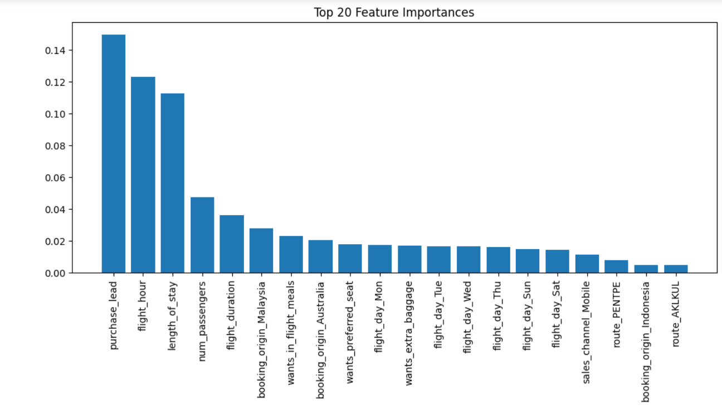
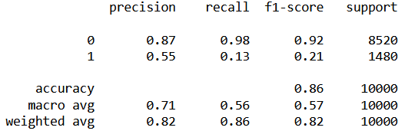
Predict customer bookings using RandomForest.
Data Preparation:
One-Hot Encoding for categorical variables.
Dropped records with missing values.
Split data into 80% training and 20% test sets.
Model Training:
RandomForestClassifier
Evaluated on test set
Model Performance:
Accuracy: 86%
ROC-AUC: 0.78
Classification Report:

